Slide 1
Day 7

Slide 2
Buildings & Places

Slide 3
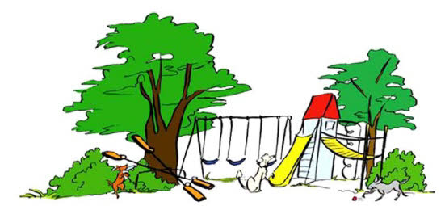
Park

Slide 4
Park

Slide 5
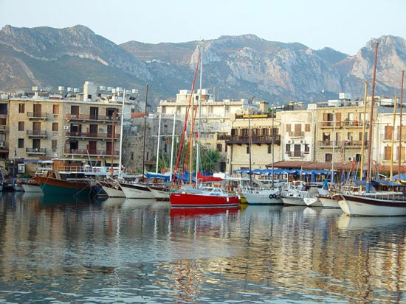
Harbour

Slide 6
Harbour

Slide 7

Beach

Slide 8
Beach

Slide 9
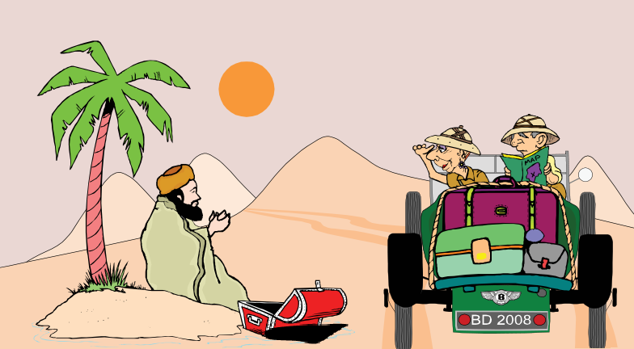
Desert

Slide 10
Desert

Slide 11

Island

Slide 12
Island

Slide 13
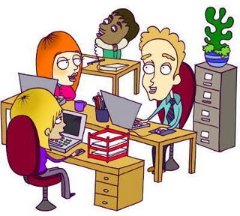
Office

Slide 14
Office

Slide 15
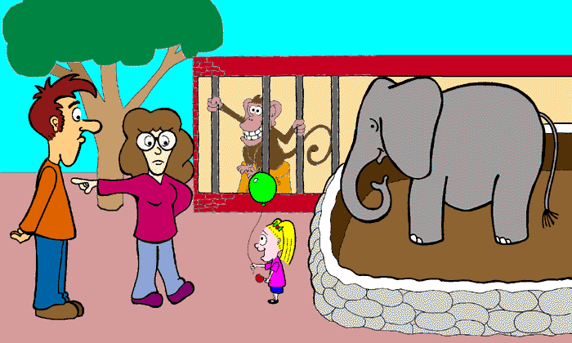
Zoo

Slide 16
Zoo

Slide 17
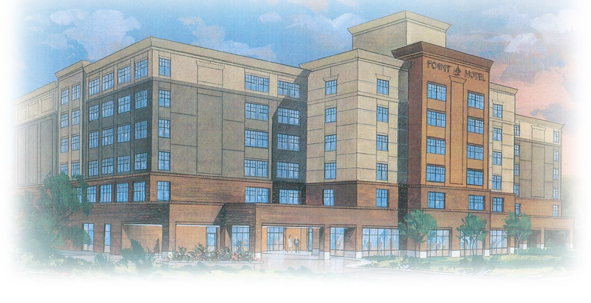
Hotel

Slide 18
Hotel

Slide 19
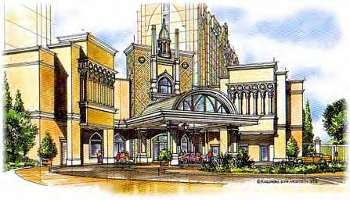
Resort

Slide 20
Resort

Slide 21
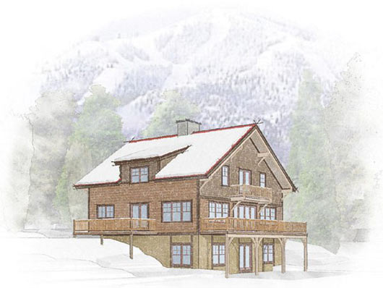
Chalet

Slide 22
Chalet

Slide 23
Animals

Slide 24
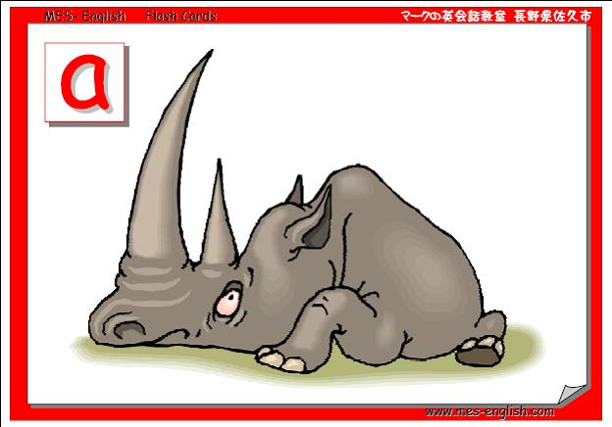

Rhino

Slide 25
Rhino

Slide 26
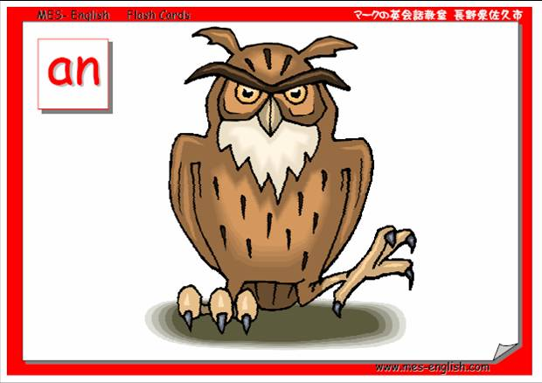
Owl

Slide 27
Owl

Slide 28
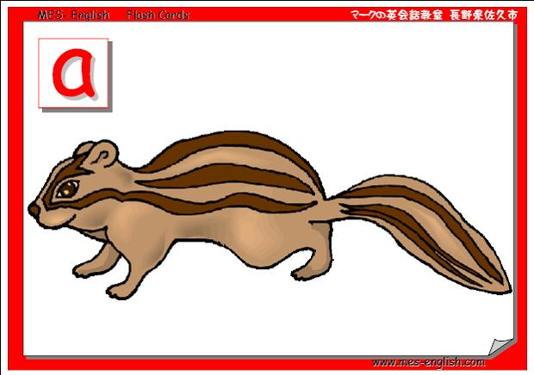
Chipmunk

Slide 29
Chipmunk

Slide 30
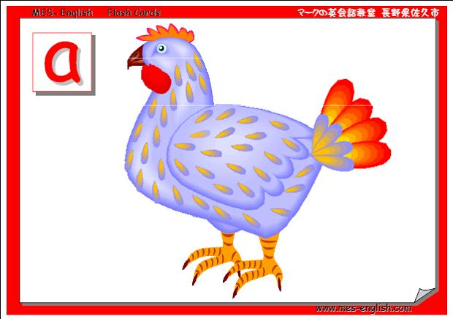
Chicken

Slide 31
Chicken

Slide 32
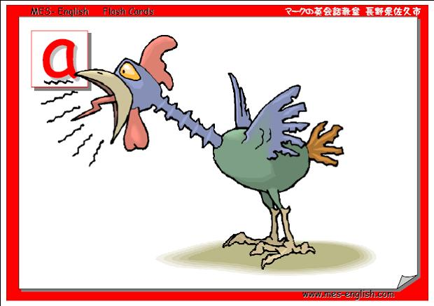
Rooster

Slide 33
Rooster

Slide 34
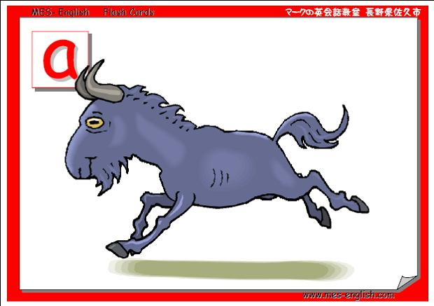
Goat

Slide 35
Goat

Slide 36
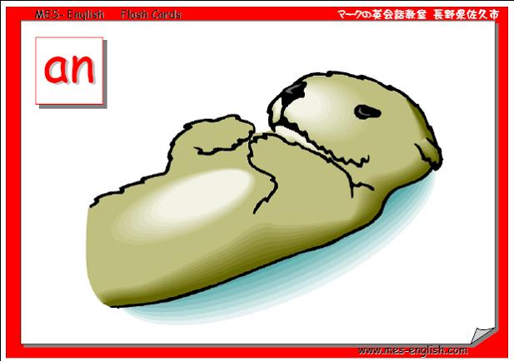
Otter

Slide 37
Otter

Slide 38
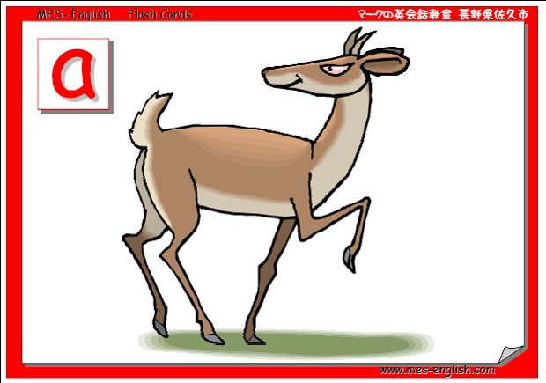
Deer

Slide 39
Deer

Slide 40
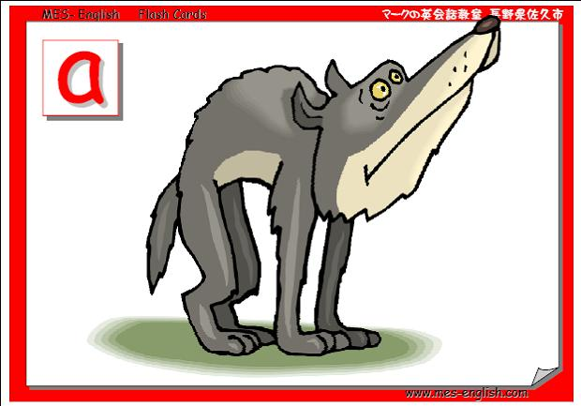
Wolf

Slide 41
Wolf

Slide 42
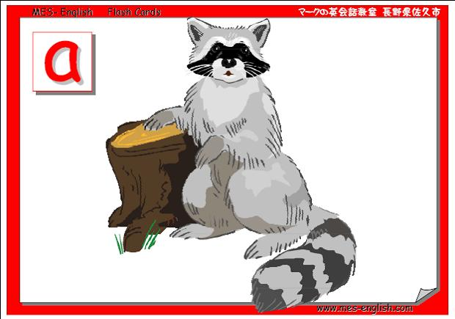
Raccoon

Slide 43
Raccoon

Slide 44
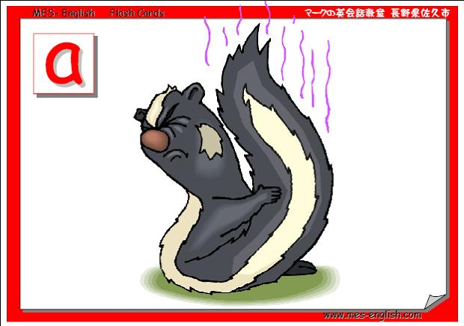
Skunk

Slide 45
Skunk

Slide 46
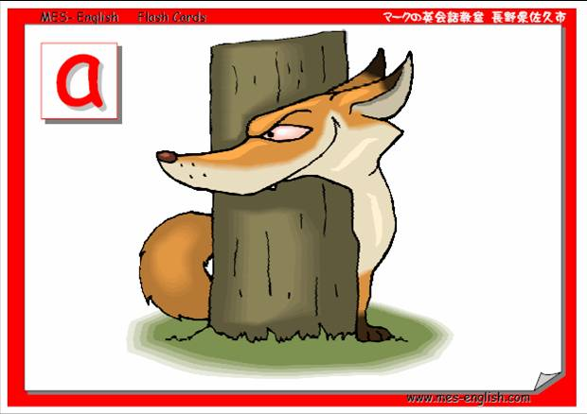
Fox

Slide 47
Fox

Slide 48
Numbers

Slide 49
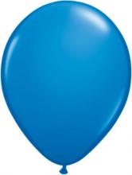
Fifty one

Slide 50
Fifty one

Slide 51
Fifty two

Slide 52
Fifty two

Slide 53
Fifty three

Slide 54
Fifty three

Slide 55
Fifty four

Slide 56
Fifty four

Slide 57
Fifty five

Slide 58
Fifty five

Slide 59
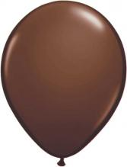
Fifty six

Slide 60
Fifty six

Slide 61
Fifty seven

Slide 62
Fifty seven

Slide 63
Fifty eight

Slide 64
Fifty eight

Slide 65
Fifty nine

Slide 66
Fifty nine

Slide 67
sixty

Slide 68
sixty

Slide 69
Daily routines

Slide 70
wake up

Slide 71
wake up

Slide 72
wash your face

Slide 73
wash your face

Slide 74
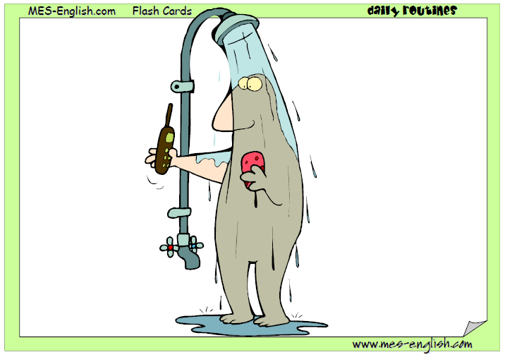
take a shower

Slide 75
take a shower

Slide 76
dry your hair

Slide 77
dry your hair

Slide 78
brush your hair

Slide 79
brush your hair

Slide 80
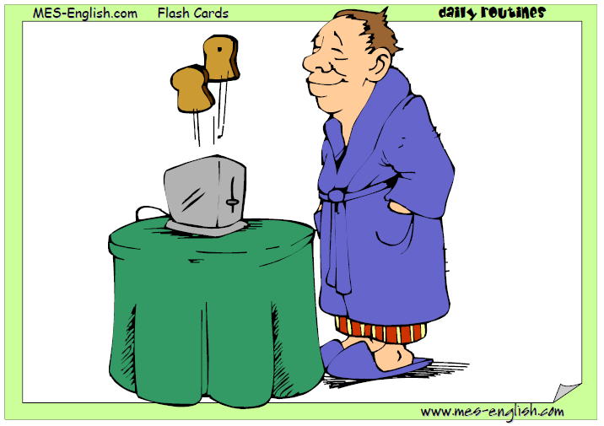
eat breakfast

Slide 81
eat breakfast

Slide 82
brush your teeth

Slide 83
brush your teeth

Slide 84
get dressed

Slide 85
get dressed

Slide 86
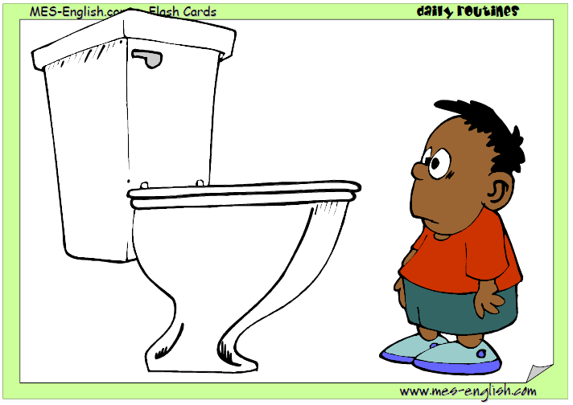
go to the bathroom

Slide 87
go to the bathroom

Slide 88
make your bed

Slide 89
make your bed

Slide 90
COLOURS AND SHAPES

Slide 91
Blue Triangle

Slide 92
Blue Triangle

Slide 93
Red Triangle

Slide 94
Red Triangle

Slide 95
Green Triangle

Slide 96
Green Triangle

Slide 97
Yellow Triangle

Slide 98
Yellow Triangle

Slide 99
Orange Triangle

Slide 100
Orange Triangle

Slide 101
Purple Triangle

Slide 102
Purple Triangle

Slide 103
Black Triangle

Slide 104
Black Triangle

Slide 105
White Triangle

Slide 106
White Triangle

Slide 107
Brown Triangle

Slide 108
Brown Triangle

Slide 109
Bathroom

Slide 110
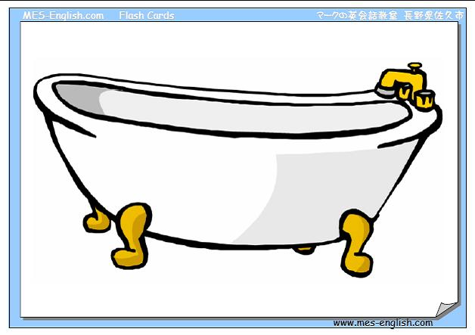
Bath

Slide 111
Bath

Slide 112
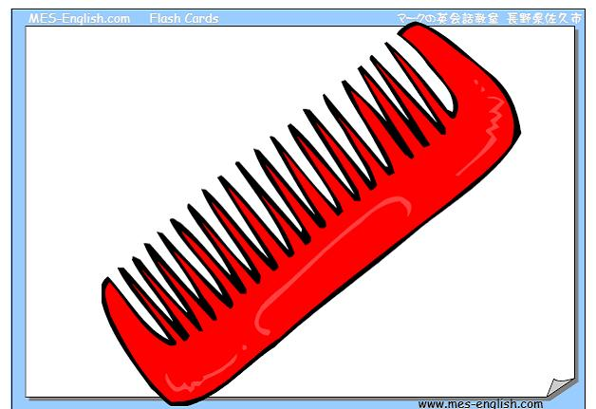
Comb

Slide 113
Comb

Slide 114
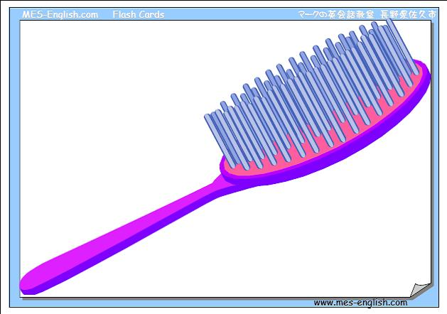
Brush

Slide 115
Brush

Slide 116
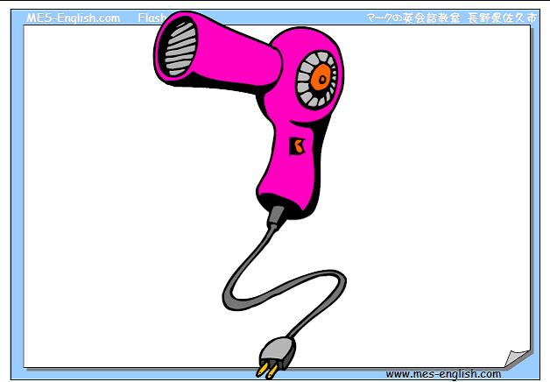
Hair dryer

Slide 117
Hair dryer

Slide 118
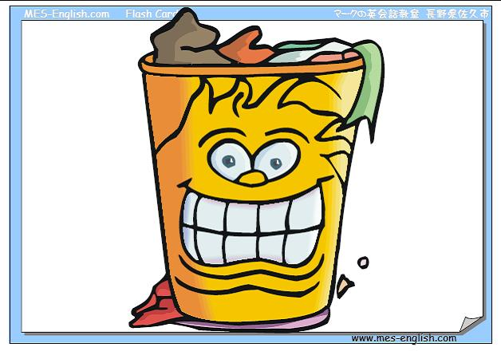
Laundry basket

Slide 119
Laundry basket

Slide 120
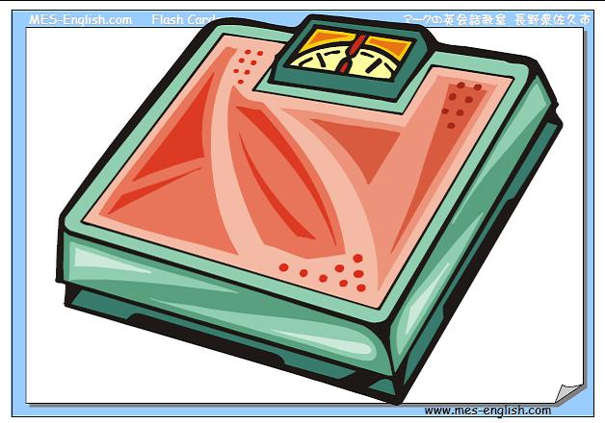
Scales

Slide 121
Scales

Slide 122
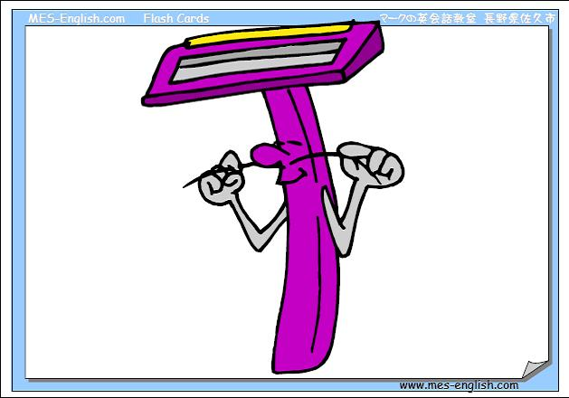
Razor

Slide 123
Razor

Slide 124
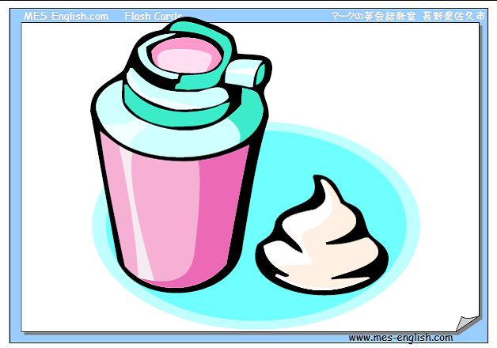
Shaving cream

Slide 125
Shaving cream

Slide 126
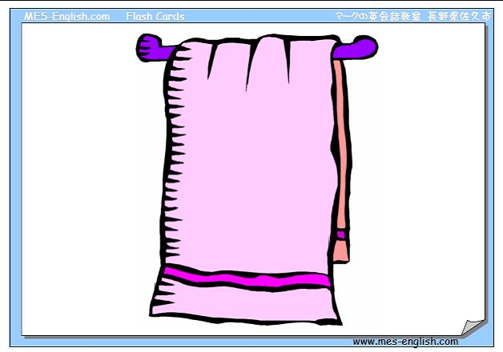
Towel

Slide 127
Towel

Slide 128
Copyright © 2005 – 2006 MES-English.com

Slide 129
Tie

Slide 130
Tie

Slide 131
Swimsuit

Slide 132
Swimsuit

Slide 133
Mittens

Slide 134
Mittens

Slide 135
Coat

Slide 136
Coat

Slide 137
Sports shirt

Slide 138
Sports shirt

Slide 139
Suit

Slide 140
Suit

Slide 141
Overalls

Slide 142
Overalls

Slide 143
Waistcoat

Slide 144
Waistcoat

Slide 145
Uniform

Slide 146
Uniform

Slide 147
Raincoat

Slide 148
Raincoat

Slide 149
Sweater

Slide 150
Sweater

Slide 151
Sweat shirt

Slide 152
Sweat shirt

Slide 153
Sweat suit

Slide 154
Sweat suit

Slide 155
Boots

Slide 156
Boots

Slide 157
High Heels

Slide 158
High Heels

Slide 159
Nature

Slide 160
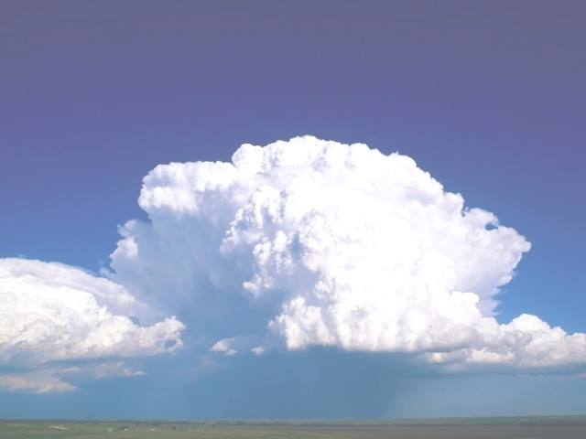

clouds

Slide 161
clouds

Slide 162
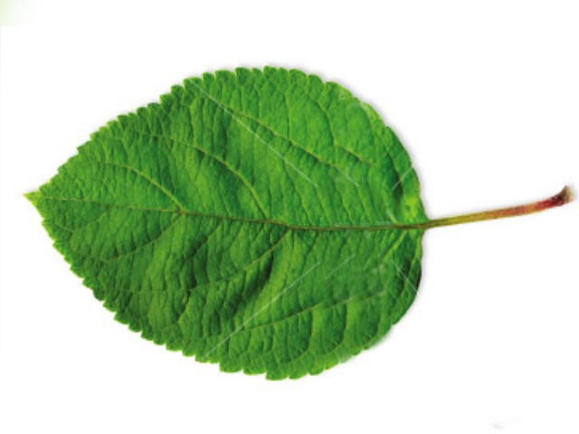
leaf

Slide 163
leaf

Slide 164
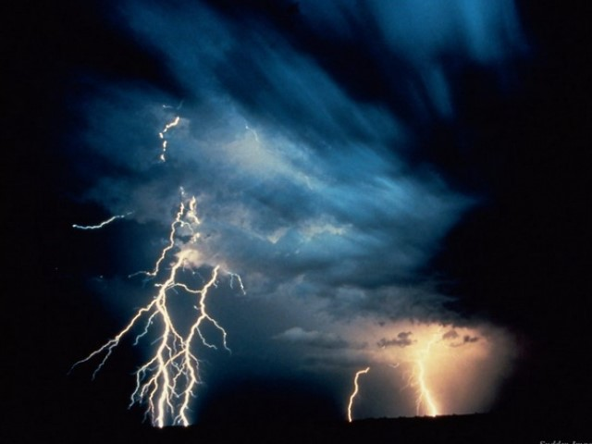
lightning

Slide 165
lightning

Slide 166
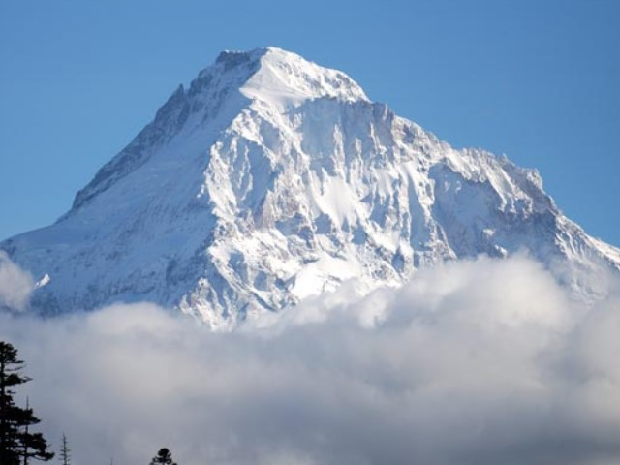
mountain

Slide 167
mountain

Slide 168
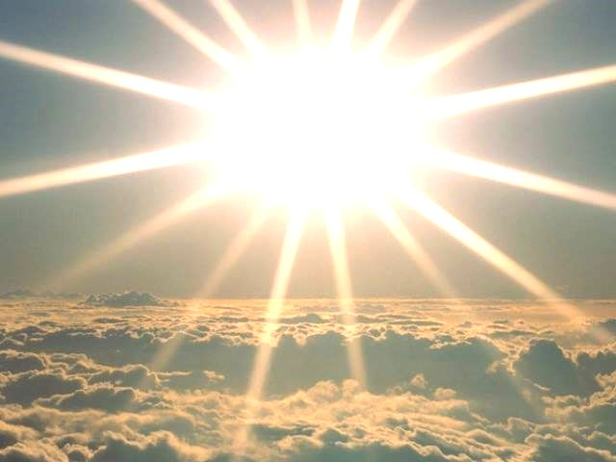
sun

Slide 169
sun

Slide 170
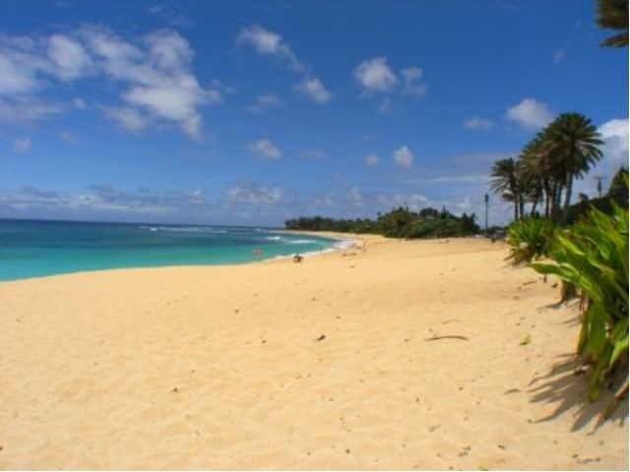
beach

Slide 171
beach

Slide 172
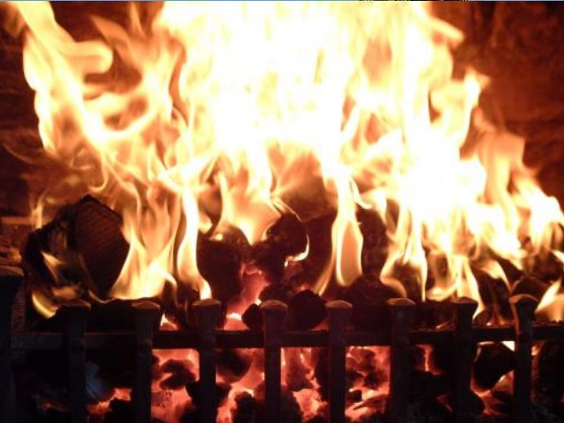
fire

Slide 173
fire

Slide 174
School

Slide 175
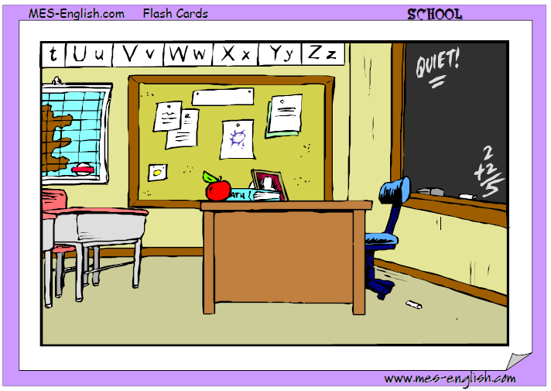
the classroom

Slide 176
the classroom

Slide 177
the art room

Slide 178
the art room

Slide 179
the library

Slide 180
the library

Slide 181
the gymnasium

Slide 182
the gymnasium

Slide 183
the science room

Slide 184
the science room

Slide 185
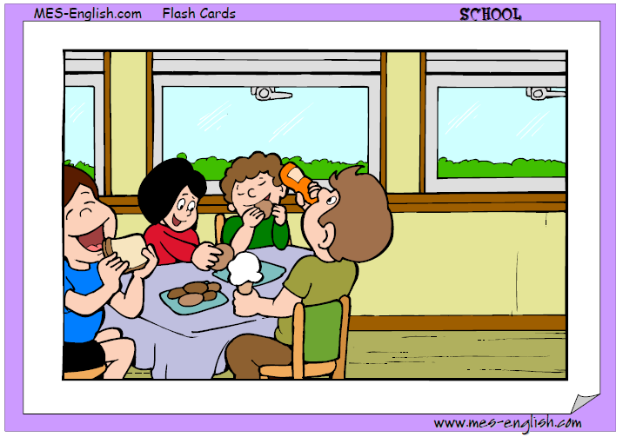
the cafeteria

Slide 186
the cafeteria

Slide 187
the lockers

Slide 188
the lockers

Slide 189
the principal’s office

Slide 190
The
principal’s office

Slide 191
the school grounds

Slide 192
the
school grounds

Slide 193
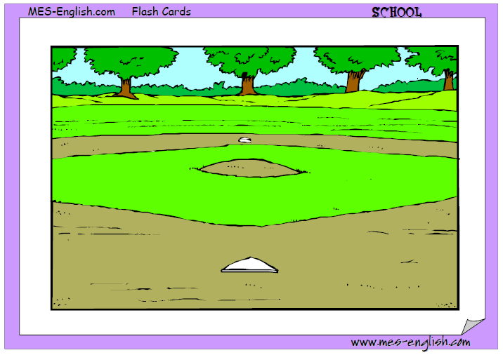
the baseball field

Slide 194
the baseball field

